Slide 1
UNIT 6
© Oxford University Press 2017. All rights reserved.

Slide 2
Content
Data Interface - Import CSV
Basic statistical operations—mean, median, mode, standard deviation
Linear regression analysis
Multiple regression
Chi-squared goodness of fit test, chi-squared test of independence
© Oxford University Press 2017. All rights reserved.

Slide 3
Data Interfaces
Objectives
  CSV files
  Excel files
  Binary files
  XML files
  JSON files
  Web data
  Databases
© Oxford University Press 2017. All rights reserved.

Slide 4
Import CSV Files into R Step-by-Step
Import CSV Files into R, the contents of a CSV file are stored in a tabular-like style with rows and columns. A delimiter string separates the values of the columns in each row.
The CSV files can be imported into the working environment and edited using built-in techniques as well as external package imports.
Assume we have a data.csv CSV file saved in the following location:
D:\RStudio\Binning\data.csv
This CSV file can be imported into R in one of three ways
Use read.csv from R’s base package (Slowest method, but works fine for smaller datasets)
© Oxford University Press 2017. All rights reserved.

Slide 5
This CSV file can be imported into R in one of three ways
Use read.csv from R’s base package (Slowest method, but works fine for smaller datasets)
To load a.csv file into the current script and operate with it, use the read.csv() method in base R.
The output is delivered as a data frame, with row numbers given to integers starting at 1.
data1 <- read.csv("D:\\RStudio\\Binning\\data.csv",
header=TRUE, stringsAsFactors=FALSE)
© Oxford University Press 2017. All rights reserved.

Slide 6
2. Use the readr package’s read csv command (2-3x faster than read.csv)
The R package “readr” is used to quickly and efficiently read huge flat files into the working space.
library(readr)
data2 <- read_csv("D:\\RStudio\\Binning\\data.csv ")
© Oxford University Press 2017. All rights reserved.

Slide 7
3. Use the data.table package’s fread (2-3 times faster than read csv)
library(data.table)
data3 <- fread("D:\\RStudio\\Binning\\data.csv ")
© Oxford University Press 2017. All rights reserved.

Slide 8
Approach 1: read.csv
If your CSV file is small enough, you may simply use Base R’s read.csv function to import it.
To avoid R converting character or categorical variables into factors, set stringsAsFactors=FALSE when using this technique.
The following code demonstrates how to import this CSV file into R using read.csv:
Let’s import the CSV data file from the location
© Oxford University Press 2017. All rights reserved.

Slide 9
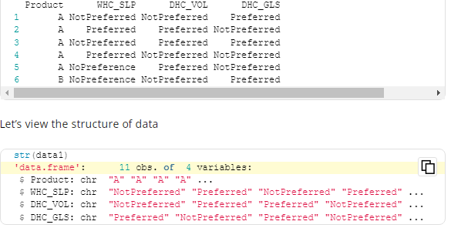
data1 <- read.csv("D:\\RStudio\\Binning\\data.csv", header=TRUE, stringsAsFactors=FALSE) head(data1)
© Oxford University Press 2017. All rights reserved.

Slide 10
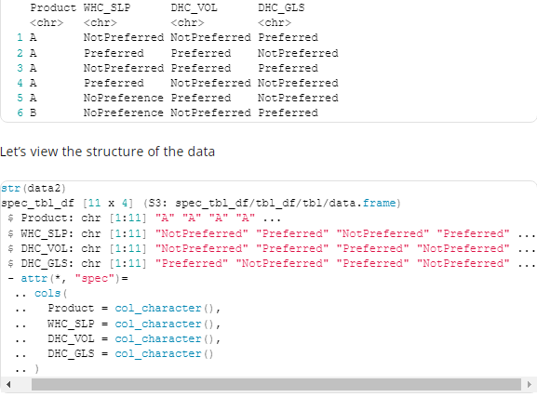
Approach 2: read_csv
You can use the read CSV function from the readr package if you’re working with larger files.
data2 <- read_csv("D:\\RStudio\\Binning\\data.csv") head(data2)
© Oxford University Press 2017. All rights reserved.

Slide 11
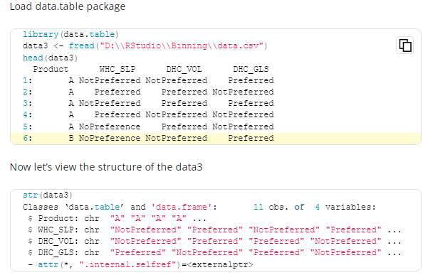
Approach 3: fread
If your CSV is exceptionally huge, the fread function from the data is the fastest way to import it into the R.
© Oxford University Press 2017. All rights reserved.

Slide 12
Basic Statistical Operations
Basic statistical operations on any numerical data includes calculation of;
Mean
Median
Mode
Standard deviation
© Oxford University Press 2017. All rights reserved.

Slide 13
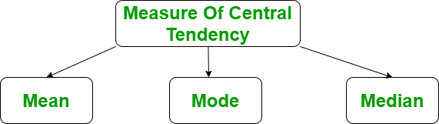
The measure of central tendency in R Language represents the whole set of data by a single value. It gives us the location of the central points. There are three main measures of central tendency:
© Oxford University Press 2017. All rights reserved.

Slide 14
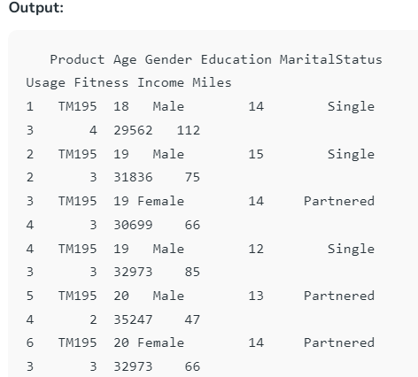
Prerequisite:
Before doing any computation, first of all, we need to prepare our data and save our data in external .txt or .csv files and it’s a best practice to save the file in the current directory. After that import, your data into R as follow:
Get the CSV file here.
# R program to import data into R
# Import the data using read.csv()
myData = read.csv("CardioGoodFitness.csv",
stringsAsFactors=F)
Print the first 6 rows
print(head(myData))
© Oxford University Press 2017. All rights reserved.

Slide 15
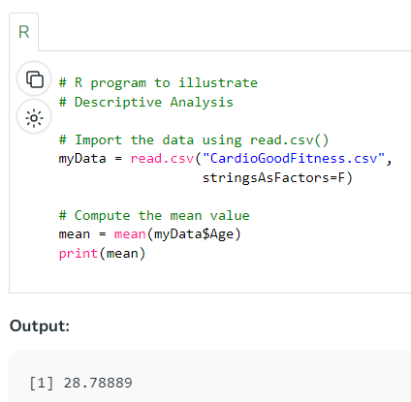
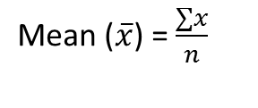
Mean in R Programming Language
It is the sum of observations divided by the total number of observations. It is also defined as average which is the sum divided by count.
Where, n = number of terms

Slide 16
Mean
Mean is calculated as the summation of all the values in the data series divided by the number of values.
Following is the function and syntax definition for calculating the mean:
mean(V, trim=0.0, na.rm= FALSE, …)
  V is the input vector;
  trim, which sorts the input vector and removes equal number of values specified from both ends of the sorted vector;
  na.rm dismisses the missing values from the input vector.
© Oxford University Press 2017. All rights reserved.

Slide 17
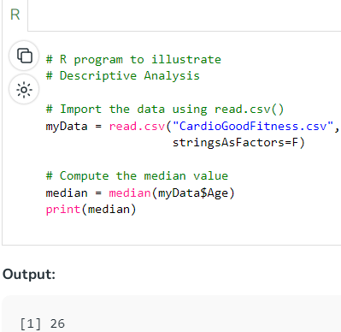
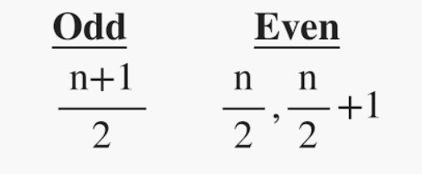
Median in R Programming Language
It is the middle value of the data set. It splits the data into two halves. If the number of elements in the data set is odd then the center element is median and if it is even then the median would be the average of two central elements.
Where n = number of terms
Syntax: median(x, na.rm = False)
Where, X is a vector and na.rm is used to remove missing value

Slide 18
Median
Median is the middle value of any data series. The R function for calculating the median is:
median(V, na.rm=FALSE)
The function takes V as the input vector and na.rm for dismissing the missing values from V to avoid anomalies.
© Oxford University Press 2017. All rights reserved.

Slide 19
Mode
Mode is defined as a value that has the maximum number of occurrences in the data series.
There may be more than one value with equal number of occurrences.
Mode can be calculated for both numerical data and character data unlike mean and median, which are applicable only for numerical data.
© Oxford University Press 2017. All rights reserved.

Slide 20
Mode in R Programming Language
It is the value that has the highest frequency in the given data set. The data set may have no mode if the frequency of all data points is the same. Also, we can have more than one mode if we encounter two or more data points having the same frequency. There is no inbuilt function for finding mode in R, so we can create our own function for finding the mode or we can use the package called modeest.
Creating a user-defined function for finding Mode
There is no in-built function for finding mode in R. So let’s create a user-defined function that will return the mode of the data passed. We will be using the table() method for this as it creates a categorical representation of data with the variable names and the frequency in the form of a table. We will sort the column Age column in descending order and will return the 1 value from the sorted values.

Slide 21
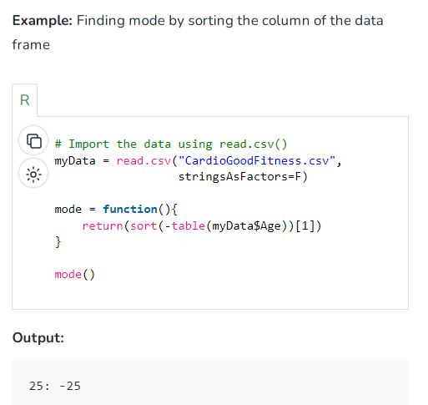
© Oxford University Press 2017. All rights reserved.

Slide 22
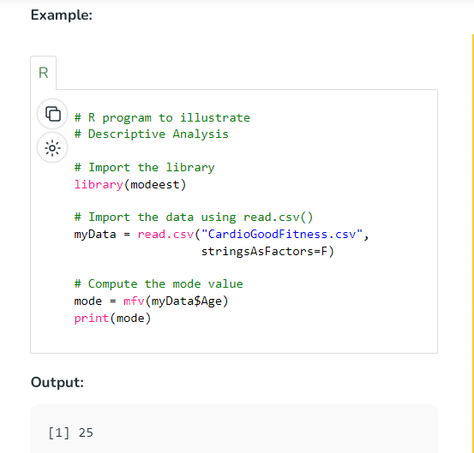
Using Modeest Package
We can use the modeest package of the R. This package provides methods to find the mode of the univariate data and the mode of the usual probability distribution.
© Oxford University Press 2017. All rights reserved.

Slide 23
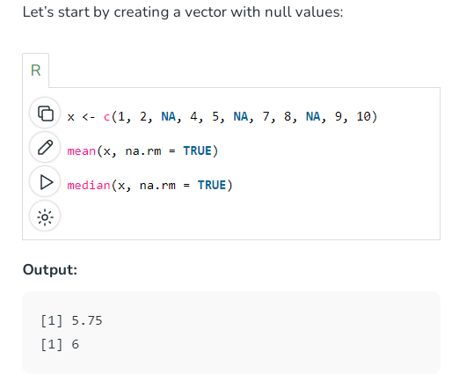
Mean and median in R for null values
When dealing with null values, you can still calculate the mean and median in R by specifying the appropriate argument to the functions. Here’s an example:
© Oxford University Press 2017. All rights reserved.

Slide 24
The arithmetic mean (average) of the non-missing numbers in x is determined by the function mean(x, na.rm = TRUE). Any NA values in x are ensured to be omitted from the calculation by the na.rm = TRUE option.
Adding up all the non-missing data is the first step in calculating the mean of x.
This function, median(x, na.rm = TRUE), finds the median of the non-missing values in x. Any NA values in x are ensured to be omitted from the calculation by the na.rm = TRUE option.
© Oxford University Press 2017. All rights reserved.

Slide 25
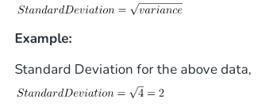
Standard Deviation in R Programming Language
Apart from calculating the mean, median, and mode, another important function for any statistical analysis of the data is calculation of standard deviation.
Standard Deviation is the square root of variance. It is a measure of the extent to which data varies from the mean. The mathematical formula for calculating standard deviation is as follows,
The R function for calculating the same is as follows with syntax definition:
sd(V, na.rm=FALSE)
Function takes any numerical vector V as input with the na.rm parameter.
© Oxford University Press 2017. All rights reserved.

Slide 26
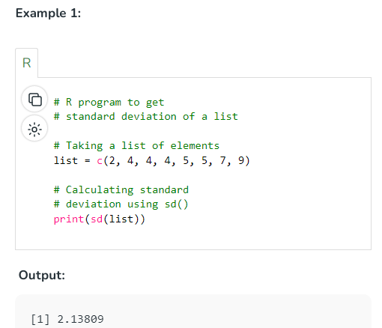
Computing Standard Deviation in R
One can calculate the standard deviation by using sd() function in R.
Syntax: sd(x)
Parameters:
x: numeric vector
© Oxford University Press 2017. All rights reserved.

Slide 27
10.3 Linear Regression Analysis
Linear regression analysis is one of the widely used methods for statistical analysis and the result of this analysis is how exactly the relationship is established between the two variables of the model.
  The first variable is known as the independent variable, which comprises the values drawn out of experimental results.
  The second variable is the dependent variable, which comprises the values derived from the independent variable.
Linear regression analysis in R constitutes model building with the help of two variables in the equation form as follows:
Yi = a + bXi + ei , i = 1, …, h
© Oxford University Press 2017. All rights reserved.

Slide 28
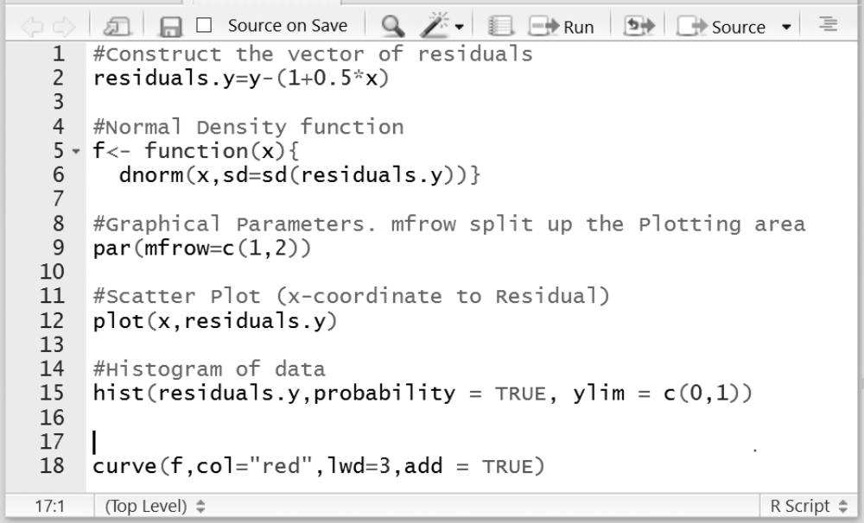
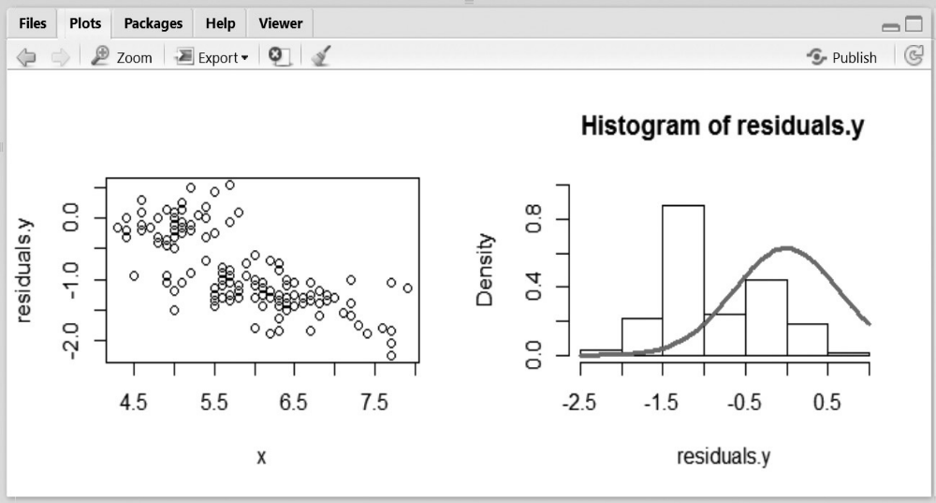
Applying curve and hist functions
© Oxford University Press 2017. All rights reserved.

Slide 29
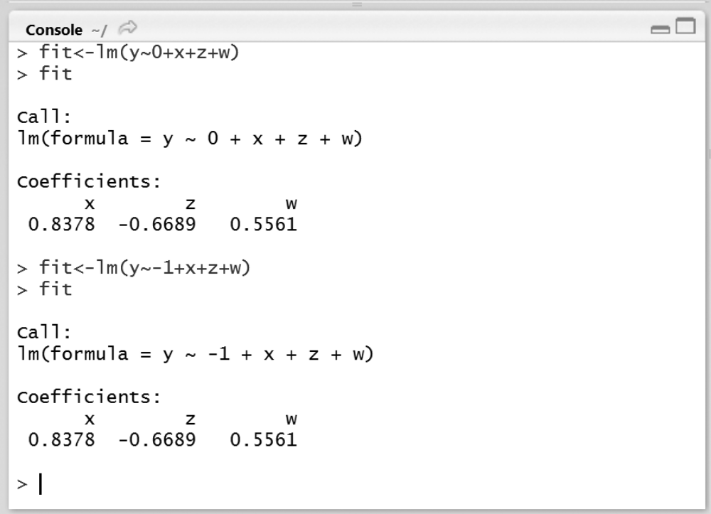
Linear Model Function
R has the lm() function, which stands for ‘linear model’
© Oxford University Press 2017. All rights reserved.

Slide 30
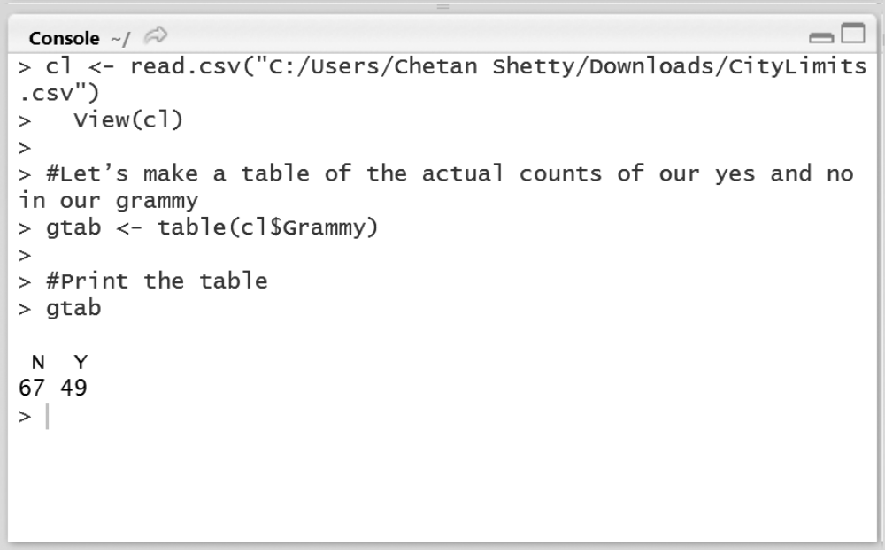
10.7 Illustration of chi-squared goodness of fit test
© Oxford University Press 2017. All rights reserved.

Slide 31
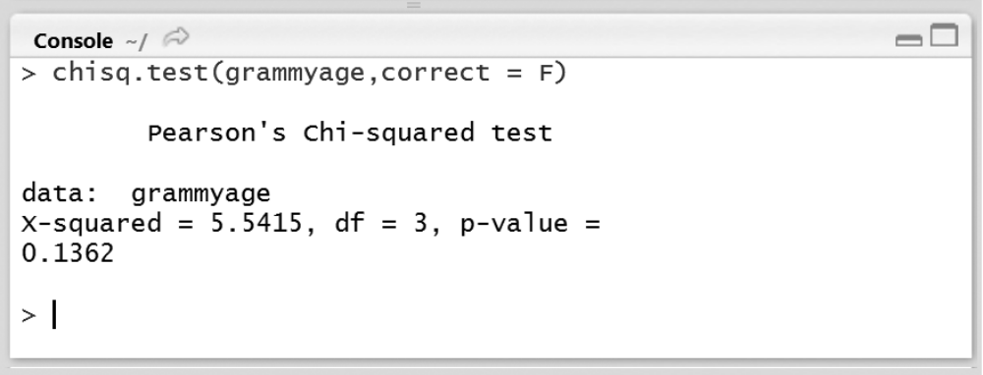
10.8 Chi-squared Test of Independence
© Oxford University Press 2017. All rights reserved.

Slide 32
Multiple Regression
#input grade of students ( Dependent Variable )
grades<- c(72,88,76,44,56,52,86,76,78,87)
grades
Absences <- c(4,3,2,1,1,4,5,2,3,1)
SAT_Score <- c(525,654,465,554,745,750,582,722,484,556)
regression <- lm(grades~ Absences + SAT_Score)
regression
summary(regression)
© Oxford University Press 2017. All rights reserved.

